Slide 2
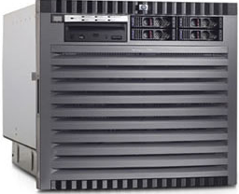
XLC Loader Infrastructure
HDD KL
Apps
Loader Application
App Server
172.21.12.167
CSV Files
DAL
Data Access Layer
Middleware
SQL server Client
Database
SQL Server 2008 R2
INPXMLD2MY (MMSDB)
O/S
Windows Server 2012
Server
172.21.12.73
Storage
HP EVA8400

